Slide 1

Salesforce Analytics

Slide 2


Opportunity
01
06
02
05
Lead
04
03

Slide 3
Report Analytics & Dashboard Analytics for Stake-Holders
Opportunity
Expected Amount
Active Opportunities
Conversion Rate
Win Rate
Loss
Trend Analysis
Running Total Expected Vs Commit Forecast Amount over Time
Running Total Active Vs Total Opportunities over Time
Closed Won Vs Total Opportunities over Time
Closed Won vs Total Closed over Time
Expected Amount by Opportunity Type
Opportunities by Industry

Slide 4
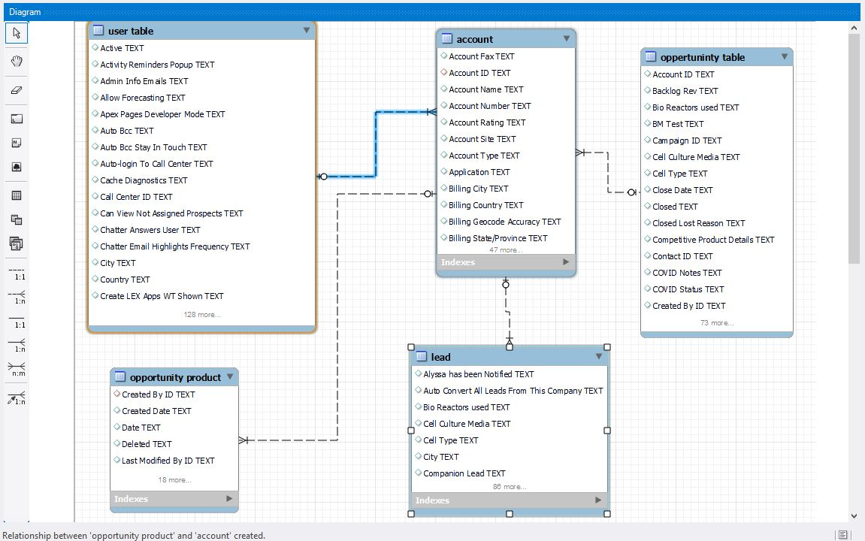
Relationships in SQL

Slide 5
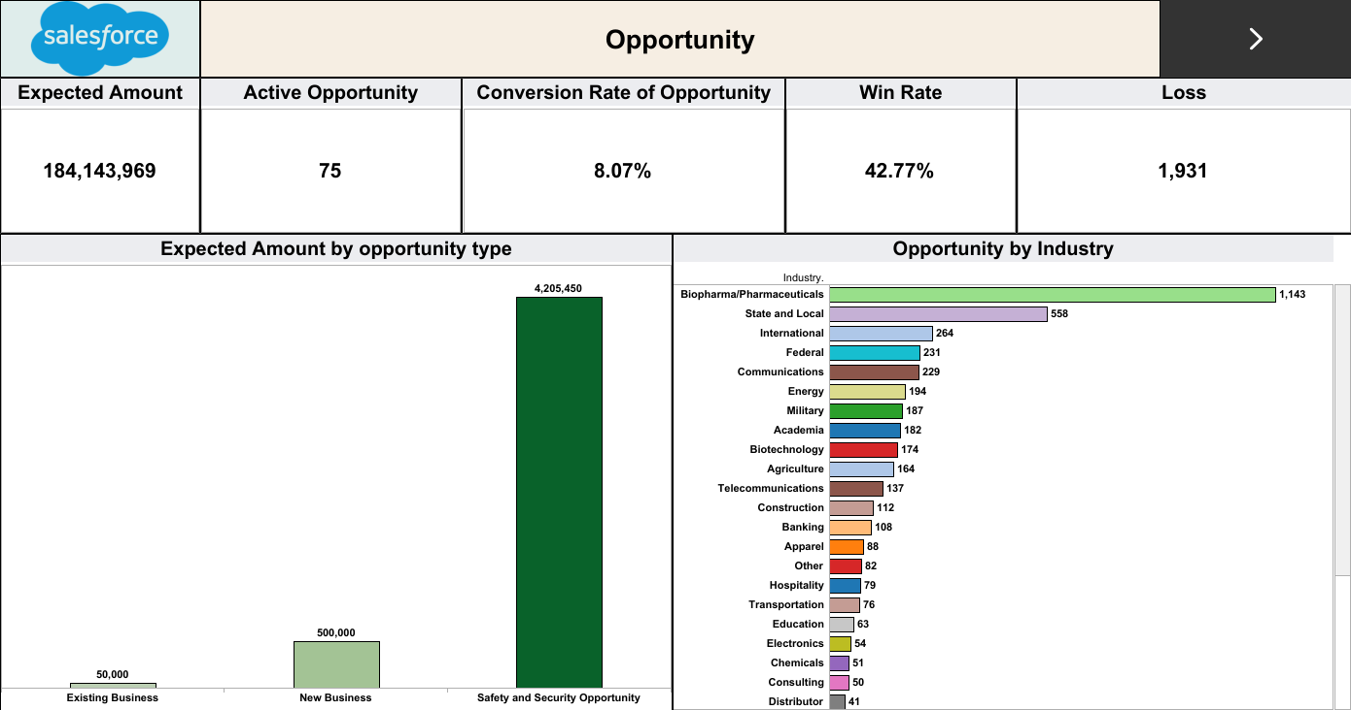

Slide 6
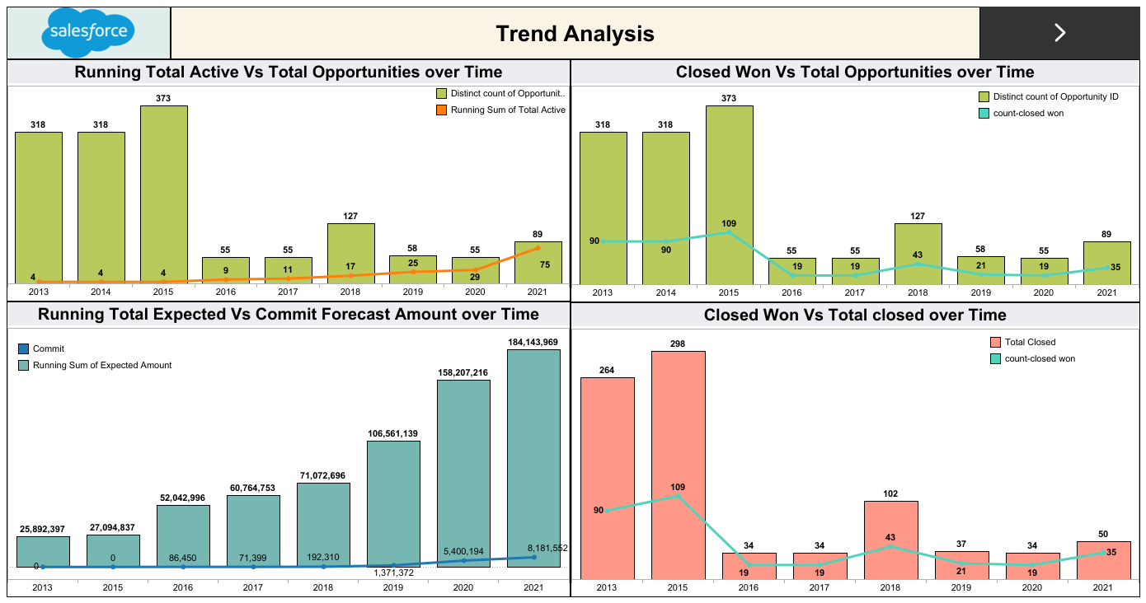

Slide 7
Report Analytics & Dashboard Analytics for Stake-Holders
Lead
Total Lead
Expected Amount from Converted Leads
Conversion Rate
Converted Accounts
Converted Opportunities
Lead By Source
Lead By industry

Slide 8
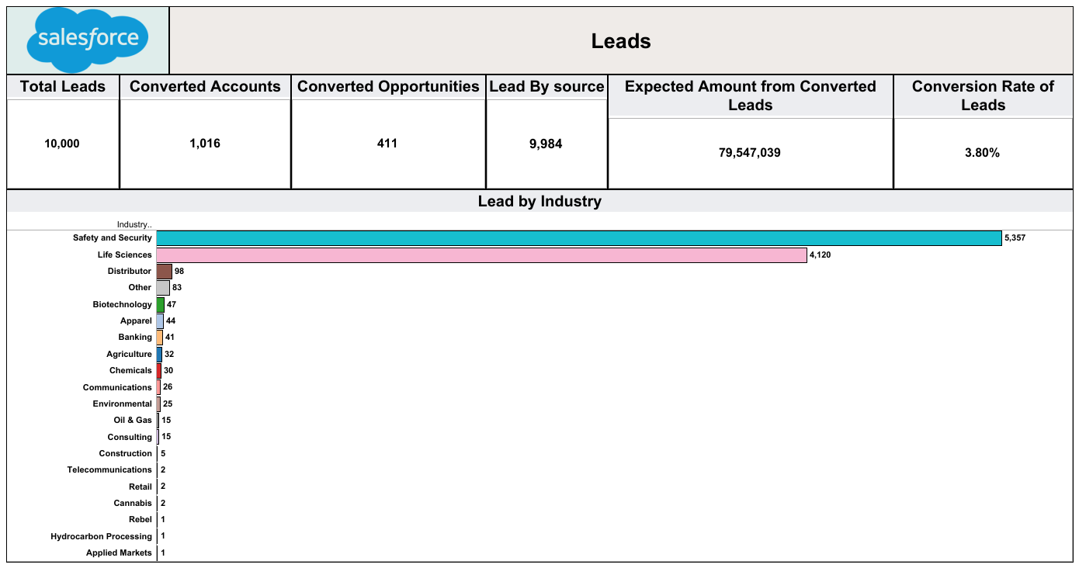

Slide 9
Thank You

